Slide 1
HTML Advance

Slide 2
HTML head
The HTML head Element
The head element is a container for all the head elements. Elements inside <head> can include scripts, instruct the browser where to find style sheets, provide meta information, and more.
The following tags can be added to the head section: <title>, <base>, <link>, <meta>, <script>, and <style>.

Slide 3
HTML head
The HTML title Element
The <title> tag defines the title of the document.
The title element is required in all HTML/XHTML documents.
The title element:
defines a title in the browser toolbar
provides a title for the page when it is added to favorites
displays a title for the page in search-engine results

Slide 4
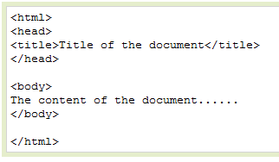
HTML head

Slide 5

HTML head
The HTML base Element
The <base> tag specifies a default address or a default target for all links on a page:

Slide 6
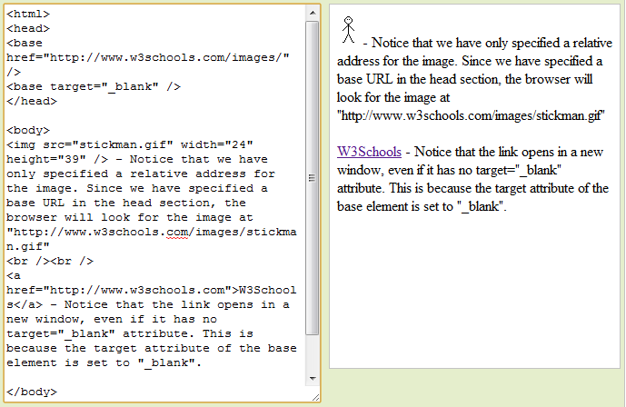
HTML head

Slide 7

HTML head
The HTML link Element
The <link> tag defines the relationship between a document and an external resource.
The <link> tag is most used to link to style sheets:

Slide 8
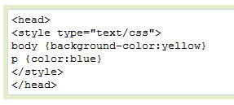
HTML head
The HTML style Element
The <style> tag is used to define style information for an HTML document.
Inside the style element you specify how HTML elements should render in a browser:

Slide 9
HTML head
The HTML meta Element
The <meta> tag provides metadata about the HTML document.
The meta element will be explained in the next chapter.
The HTML script Element
The <script> tag is used to define a client-side script, such as a JavaScript.
The script element will be explained in a later chapter.

Slide 10
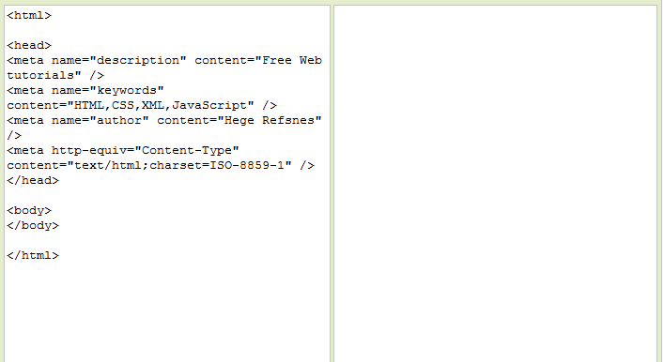
HTML head

Slide 11
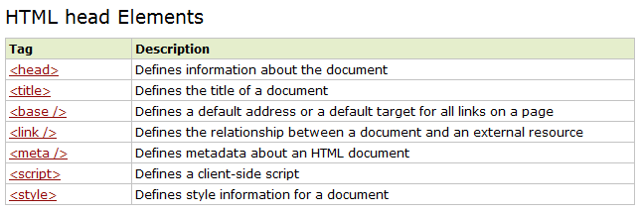
HTML head

Slide 12
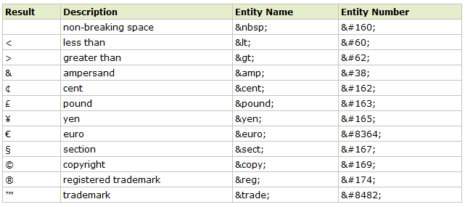
HTML Useful Character Entities

Slide 13
URL - Uniform Resource Locator
When you click on a link in an HTML page, an underlying <a> tag points to an address on the world wide web.
A Uniform Resource Locator (URL) is used to address a document (or other data) on the world wide web.
A web address, like this: http://www.w3schools.com/html/default.asp follows these syntax rules:

Slide 14

scheme - defines the type of Internet service. The most common type is http
host - defines the domain host (the default host for http is www)
domain - defines the Internet domain name, like w3schools.com
:port - defines the port number at the host (the default port number for http is 80)
path - defines a path at the server (If omitted, the document must be stored at the root directory of the web site
filename - defines the name of a document/resource

Slide 15
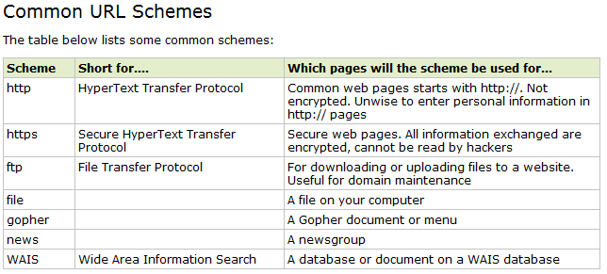
URL - Uniform Resource Locator

Slide 16
www.webng.com
hiepdlu.webng.com
Login→ Files manager
Tao thu muc
Tao file
Up load file
…
Bai tap

Slide 17
Dia CD web ca nhan
Moi ban ghi ra 1 dia
Dan nhan:
Ho ten
MSSV
Chu de web ca nhan
URL (hiepitdlu.webng.com/index.html)

